Slide 1
Random graphs & epidemic algorithms
Laurent Massoulié & Fabien Mathieu
laurent.massoulie@inria.fr & fabien.mathieu@inria.fr

Slide 2
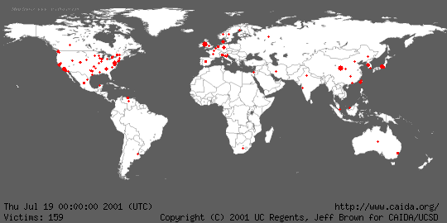
The “Code Red” Internet Worm

Slide 3
Epidemics & rumours
Propagate fast
Hard to eradicate
Operate a decentralized algorithm: based on local contacts only
Desirable properties for information dissemination
A landmark article:
“Epidemic algorithms for replicated database maintenance” (Demers et al. Xerox PARC, 1987)
→ Proposed to imitate epidemic propagation for information dissemination

Slide 4
Recent regain of interest
Emerging Networks (as opposed to engineered, tightly managed communication networks)
Peer-to-Peer systems
Wireless ad hoc and sensor networks
Online social networks
→ raise new specific problems
→ have potentially massive scale
→ necessitate decentralized operation
Examples of target functionalities
broadcast (i.e. send-to-all-nodes)
Content sharing(Bittorrent, Gnutella,…)
Live streaming (a la PPLive)
Video-on-Demand
“Viral Marketing” (=ad spreading)

Slide 5
Networks and topologies
Internet (physical) graphs
AS-level
Router-level
P2P (logical) graphs
Gnutella, BitTorrent
Online Social networks
Email, Facebook, Tweeter,…
Topologies may differ widely
Planar graphs, “expanders”, random graphs, small world networks, power-law graphs,…

Slide 6
Objectives of this course
Understand
Simple distributed algorithms suited to “Emerging networks”
Impact of network topologies on performance
Emphasis on
Models based on graph theory and discrete probability
Characterization of algorithm performance as network size scales to infinity

Slide 7
Course Outline (1)
S1: « Infect-and-Die » dynamics (on a complete graph)
The SIR epidemic process
Digression: Galton-Watson processes and the survival of species
Erdös-Rényi random graphs
Key properties (giant component, connectivity)
S2: « Infect-forever » dynamics
Time to complete infection=broadcast (push model and push-pull model)
Impact of graph topology on broadcast time for push-pull (D. Shah)
Live streaming and competing epidemics (random peer-latest chunk on complete graph)
S3: Epidemics for information maintenance
The SIS epidemic process
Impact of graph topology on survival time of information
The path replication method to minimize content search time

Slide 8
Course Outline (2)
S4: The small-world phenomenon
Small worlds according to Strogatz and Watts: low diameter
Small worlds according to Kleinberg: navigable graphs
Network coordinates: landmarks and min-plus coordinates
S5: Distributed computation of aggregates
Linear averaging and impact of network topology on convergence speed
Basics on random walks and their “mixing time”
“Sample-and-Collide” algorithm for network size estimation
S6: Power-law random graphs
Barabasi-Albert networks and the preferential attachment dynamics
Other examples of power-laws through preferential attachment (Yule process)
Power laws as optimal design

Slide 9
Course Outline (3)
S7: Viral marketing and epidemics optimization
NP-hardness and submodularity property
Bounded suboptimality of greedy seed selection
Further examples of submodular problems
S8: Community detection
Stochastic block models of structured networks
Spectral clustering algorithms
Performance guarantees for sufficiently rich observations
S9: To Be Defined
Mean field models?
Consensus algorithms?
Iterative scaling algorithms?

Slide 10
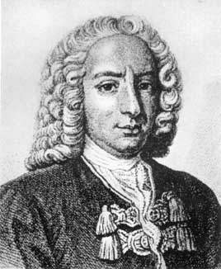
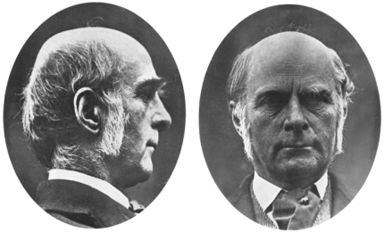

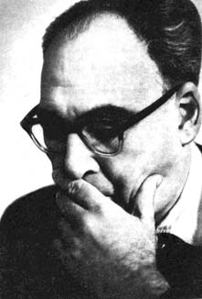
The founding fathers (of epidemic analysis)
1766 Daniel Bernoulli (small pox / petite vérole)
1873 Sir Francis Galton (extinction of family names / species)
1959 Paul Erdős and Alfred Rényi (random graphs)

Slide 11
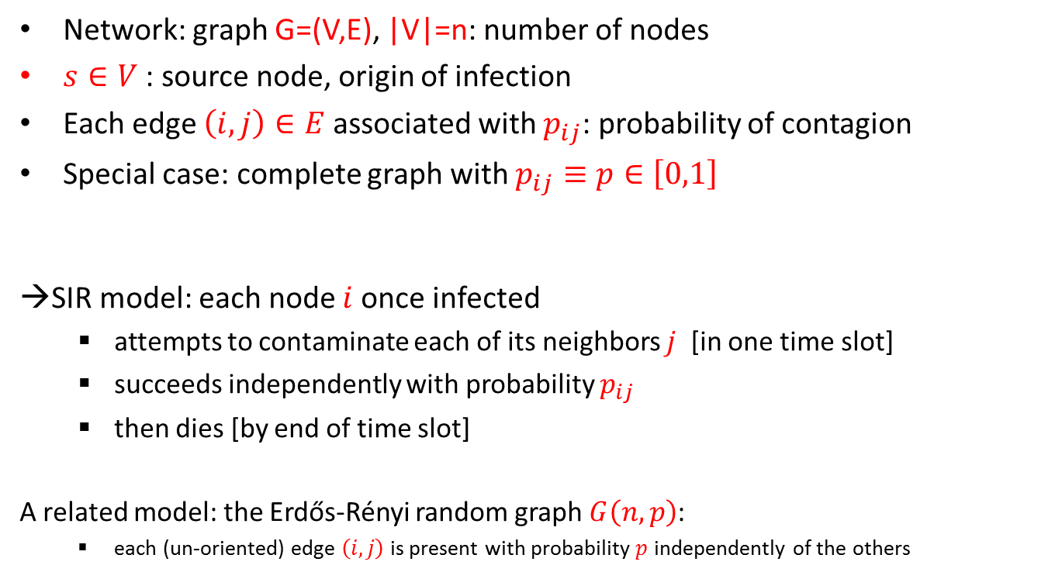
Course 1: “Infect-and-die” processes SIR (Susceptible-Infective-Removed) dynamics
Network: graph G=(V,E), |V|=n: number of nodes
$s∈V$: source node, origin of infection
Each edge $\left(i,j\right)∈E$ associated with $p_{ij}$: probability of contagion
Special case: complete graph with $p_{ij}≡p∈\left[0,1\right]$
→SIR model: each node $i$once infected
attempts to contaminate each of its neighbors $j$ [in one time slot]
succeeds independently with probability $p_{ij}$
then dies [by end of time slot]
A related model: the Erdős-Rényi random graph $G\left(n,p\right)$:
each (un-oriented) edge $\left(i,j\right)$is present with probability $p$ independently of the others

Slide 12
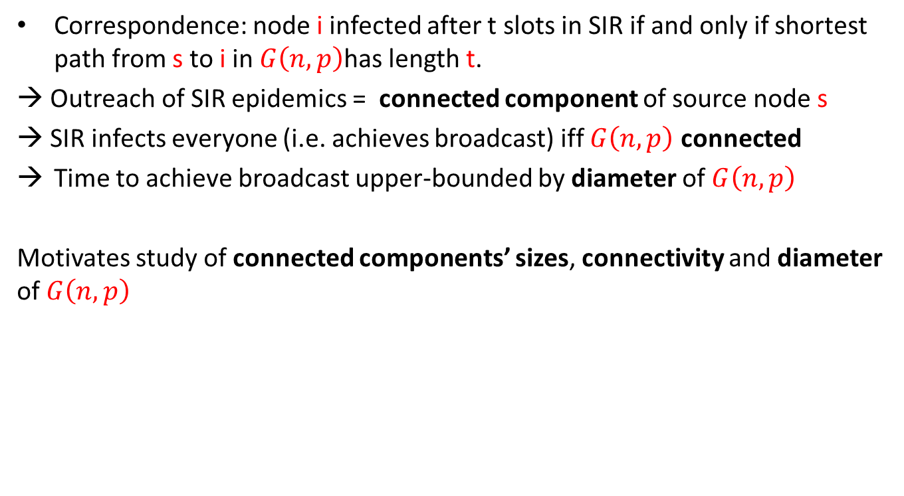
From E-R graph to SIR process
Correspondence: node i infected after t slots in SIR if and only if shortest path from s to i in $G\left(n,p\right)$has length t.
→ Outreach of SIR epidemics = connected component of source node s
→ SIR infects everyone (i.e. achieves broadcast) iff $G\left(n,p\right)$ connected
Time to achieve broadcast upper-bounded by diameter of $G\left(n,p\right)$
Motivates study of connected components’ sizes, connectivity and diameter of $G\left(n,p\right)$

Slide 13
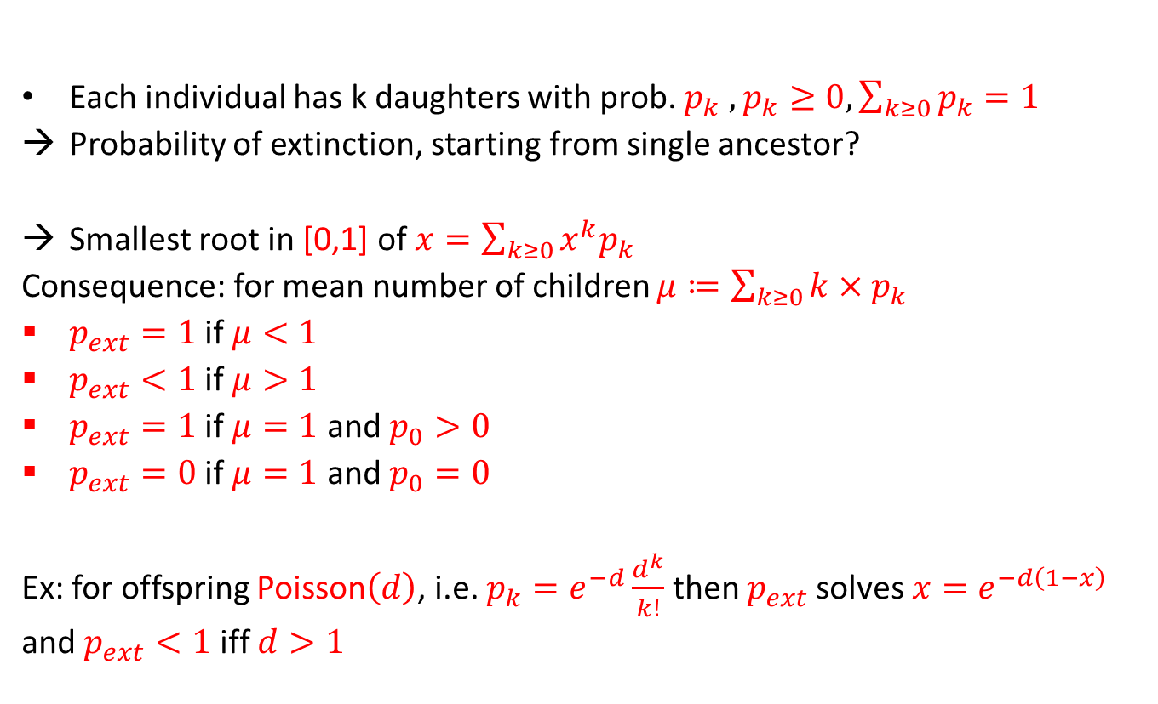
Digression: Galton-Watson branching processes
Each individual has k daughters with prob. $p_{k}$ $,p_{k}≥0, \sum_{k≥0}{p_{k}=1}$
Probability of extinction, starting from single ancestor?
Smallest root in [0,1] of $x=\sum_{k≥0}{x^{k}p_{k}}$
Consequence: for mean number of children $μ≔\sum_{k≥0}{k{×p}_{k}}$
$p_{ext}=1$ if $μ<1$
$p_{ext}<1$ if $μ>1$
$p_{ext}=1$ if $μ=1$ and $p_{0}>0$
$p_{ext}=0$ if $μ=1$ and $p_{0}=0$
Ex: for offspring Poisson$\left(d\right)$, i.e. $p_{k}=e^{−d}\frac{d^{k}}{k!}$ then $p_{ext}$solves $x=e^{−d\left(1−x\right)}$
and $p_{ext}<1$ iff $d>1$
s

Slide 14
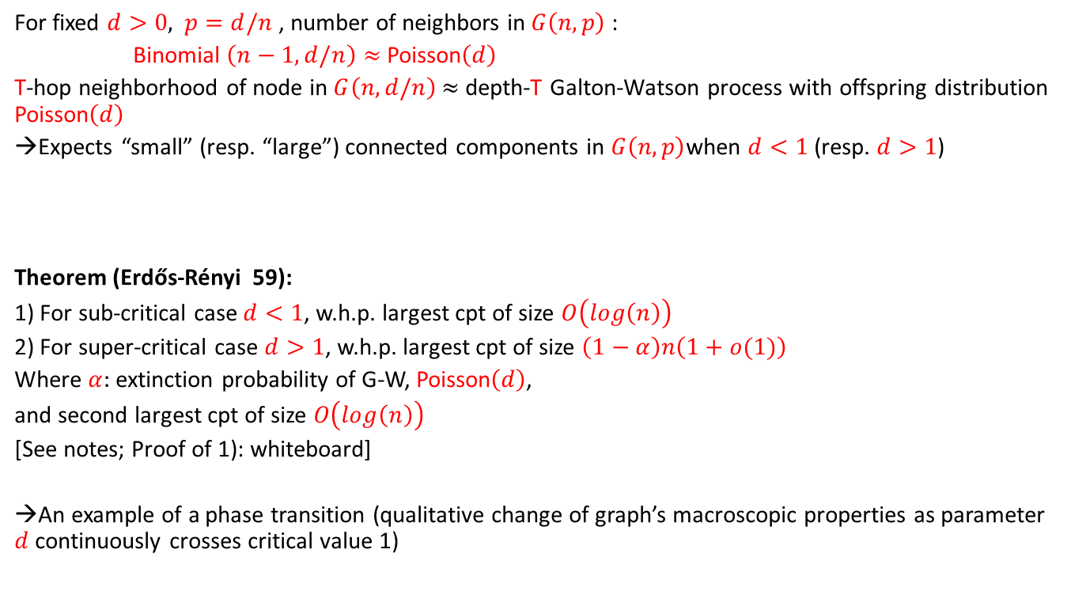
From Galton-Watson to Erdős-Rényi
For fixed $d>0,$ $p=d/n$ , number of neighbors in $G\left(n,p\right)$ :
Binomial $\left(n−1,d/n\right)≈$ Poisson$\left(d\right)$
T-hop neighborhood of node in $G\left(n,d/n\right)$ $≈$ depth-T Galton-Watson process with offspring distribution Poisson$\left(d\right)$
→Expects “small” (resp. “large”) connected components in $G\left(n,p\right)$when $d<1$ (resp. $d>1$)
Theorem (Erdős-Rényi 59):
1) For sub-critical case $d<1$, w.h.p. largest cpt of size $O\left(log\left(n\right)\right)$
2) For super-critical case $d>1$, w.h.p. largest cpt of size $\left(1−α\right)n\left(1+o(1)\right)$
Where $α:$ extinction probability of G-W, Poisson$\left(d\right)$,
and second largest cpt of size $O\left(log\left(n\right)\right)$
[See notes; Proof of 1): whiteboard]
→An example of a phase transition (qualitative change of graph’s macroscopic properties as parameter $d$ continuously crosses critical value 1)

Slide 15
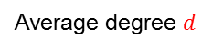
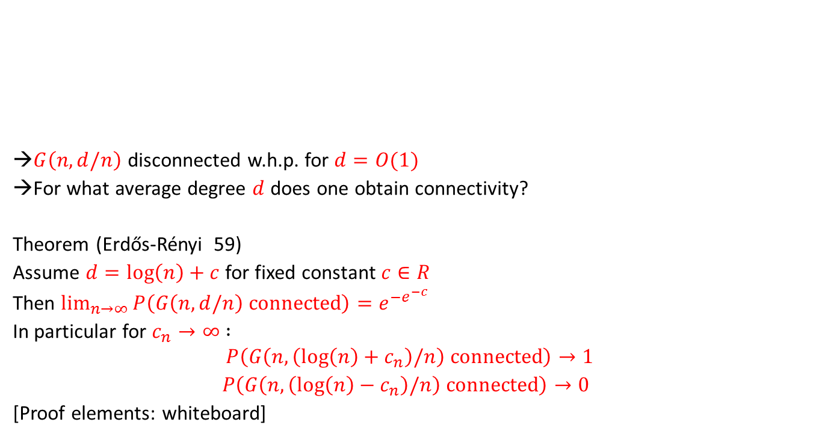
Connectivity of Erdős-Rényi graphs
Density $\left|C\right|/n$ of largest connected cpt $C$in $G\left(n,a/n\right)$
→$G\left(n,d/n\right)$ disconnected w.h.p. for $d=O(1)$
→For what average degree $d$ does one obtain connectivity?
Theorem (Erdős-Rényi 59)
Assume $d=log\left(n\right)+c$ for fixed constant $c∈R$
Then $\lim_{n→∞}{P\left(G\left(n,d/n\right) \text{connected}\right)}=e^{{−e}^{−c}}$
In particular for $c_{n}→∞$ $:$
$$P\left(G\left(n,\left(log\left(n\right)+c_{n}\right)/n\right) \text{connected}\right)→1$$
$P\left(G\left(n,\left(log\left(n\right)−c_{n}\right)/n\right) \text{connected}\right)→0$
[Proof elements: whiteboard]
1
Average degree $d$
1

Slide 16
Talk outline (1): Single message dissemination
Unstructured case:
Fraction of receivers reached
giant components in random graphs;
ODE models: impact of “rumour mongering”;
Probability of successful broadcast
Erdos-Renyi phase transition for graph connectivity
Time to successful broadcast
Infect and die model: Diameter of random graphs
Infect forever model: Pittel’s identity
Topologically structured case:
Time to broadcast and graph diameter
Time to specific target in interest-based topologies
Information persistence:
Fast extinction and spectral radius of graph
Long survival and isoperimetric constant of graph
Graph adaptation
Metropolis algorithm and failure resilience
Notes:
A (biased) survey of mathematical models, results and open problems in the area

Slide 17
Talk outline (2): Multi-message dissemination
File dissemination and time to broadcast:
K+log(N) lower bound
Random network coding:
Optimality of “algebraic gossip”
Badness of random pull
Optimality without network coding
Priority push+source coding
Interleaved push and pull
Live streaming and broadcast rate:
The min(min-cut) upper bound
Optimality of random linear coding
Optimality of “Random-Useful-Push”

Slide 18
Talk outline (1): Single message dissemination
Unstructured case:
Fraction of receivers reached
giant components in random graphs;
ODE models: impact of “rumour mongering”;
Probability of successful broadcast
Erdos-Renyi phase transition for graph connectivity
Time to successful broadcast
Infect and die model: Diameter of random graphs
Infect forever model: Pittel’s identity
Topologically structured case:
Time to broadcast and graph diameter
Time to specific target in interest-based topologies
Information persistence:
Fast extinction and spectral radius of graph
Long survival and isoperimetric constant of graph
Graph adaptation
Metropolis algorithm and failure resilience
Notes:
A (biased) survey of mathematical models, results and open problems in the area

Slide 19
Basic Model
N nodes (think of Internet hosts);
results stated in the limit N→1
Source node has message to disseminate
Each node forwards message (after receiving it) to random subset of target nodes
Size of subset: k with probability q(k)
Unstructured case: subset chosen uniformly from all size k-subsets

Slide 20
Fraction reached [Martin-Löf,86]
q(k) : probability of k targets
f= ∑_{k} k q(k) : mean number of targets;
Probability of reaching positive fraction tends to 1-p_{ext} where
…conditionally upon which fraction π of reached nodes:
Fixed redundancy level f yields fixed fraction π<1 (irrespective of system size).
Special case: q(k) Binomial(N,p): Reed-Frost epidemics

Slide 21
Adaptive scheme (rumour mongering algorithm)
Temporal dynamics:
forward to random targets at instants of rate f Poisson process.
When receiving a duplicate, stop forwarding with probability p;
Stop forwarding anyway at expiration of Exponential timer with mean 1.
When p=0, a special case of previous model, with q(k) : Geometric distribution, parameter f/(1+f)

Slide 22
Analysis via ODE’s [Kurtz’s theorem]
a, r: proportions of active / reached nodes satisfy:
Hence:
Final proportion π reached solves a(π)=0;
Number of messages per node:
p does not affect redundancy / reliability trade-off.

Slide 23
(r,a) trajectories
Large f and p:
achieves large fraction π while maintaining active fraction low.

Slide 24
Talk outline (1): Single message dissemination
Unstructured case:
Fraction of receivers reached
giant components in random graphs;
ODE models: impact of “rumour mongering”;
Probability of successful broadcast
Erdos-Renyi phase transition for graph connectivity
Time to successful broadcast
Infect and die model: Diameter of random graphs
Infect forever model: Pittel’s identity
Topologically structured case:
Time to broadcast and graph diameter
Time to specific target in interest-based topologies
Information persistence:
Fast extinction and spectral radius of graph
Long survival and isoperimetric constant of graph
Graph adaptation
Metropolis algorithm and failure resilience
Notes:
A (biased) survey of mathematical models, results and open problems in the area

Slide 25
Communication Graph
Nodes ≡ members;
Source node generates msg;
Arrows: successful msg transmission;
Node receives msg if reached by directed path from source
Successful propagation if directed path from source to any other node

Slide 26
Probability of successful broadcast: Erdös-Renyi law (59)
Undirected graph on N nodes, each edge present with probability p_{N}, is connected with probability
provided f := (N-1)p_{N}=log(N)+c+o(1).
Corresponds to Reed-Frost epidemics,
i.e. q(k) : Binomial(N-1,p_{N}).
Non-Binomial q(k): directed path from source to any other node with probability p_{connect} under same condition on mean out-degree f [Ball&Barbour,90].

Slide 27
Talk outline (1): Single message dissemination
Unstructured case:
Fraction of receivers reached
giant components in random graphs;
ODE models: impact of “rumour mongering”;
Probability of successful broadcast
Erdos-Renyi phase transition for graph connectivity
Time to successful broadcast
Infect and die model: Diameter of random graphs
Infect forever model: Pittel’s identity
Topologically structured case:
Time to broadcast and graph diameter
Time to specific target in interest-based topologies
Information persistence:
Fast extinction and spectral radius of graph
Long survival and isoperimetric constant of graph
Graph adaptation
Metropolis algorithm and failure resilience
Notes:
A (biased) survey of mathematical models, results and open problems in the area

Slide 28
Time to successful broadcast
Infect and die model:
once message received, node forwards it in next time slot to all of its targets.
→Time to reach node j: d_{G}(s,j) where d_{G} represents distance in communication graph
Special case: Erdos-Renyi graph with Np_{N} >>log(N) (hence connected)
Broadcast time ≤ graph diameter ≤
([Bollobas 01]; essentially smallest possible diameter, given upper bound of order Np_{N} on node degrees)

Slide 29
Time to successful broadcast
Infect forever model:
Once message received, node forwards it in all subsequent time slots to f random targets.
→Time to reach all nodes:
[Pittel 87]
A variant: each node forwards message at instants of rate 1 Poisson process.
Then:
→In both cases, logarithmic –hence small- broadcast time.

Slide 30
Talk outline (1): Single message dissemination
Unstructured case:
Fraction of receivers reached
giant components in random graphs;
ODE models: impact of “rumour mongering”;
Probability of successful broadcast
Erdos-Renyi phase transition for graph connectivity
Time to successful broadcast
Infect and die model: Diameter of random graphs
Infect forever model: Pittel’s identity
Topologically structured case:
Time to broadcast and graph diameter
Time to specific target in interest-based topologies
Information persistence:
Fast extinction and spectral radius of graph
Long survival and isoperimetric constant of graph
Graph adaptation
Metropolis algorithm and failure resilience
Notes:
A (biased) survey of mathematical models, results and open problems in the area

Slide 31
Topologically structured scenarios
The Internet…
P2P scenario: nodes organised in an overlay, i.e. graph reflecting “who knows who” relations.
Broadcast time?
1) Infect and die model: nodes forward message to all overlay neighbours when message received.
Then:
2) Random neighbour selection: Node forwards to particular neighbour after random timer (fixed distribution) expires.
Then:
→ Graph diameter dominates performance.

Slide 32
When topology reflects interest:
[Kempe,Kleinberg,Demers 01]
Nodes: arranged in a grid.
Grid reflects “proximity of interest”:
nodes close to source according to grid distance want message faster.
Naïve solution: gossip only along edges of grid.
→Good for near-by nodes;
→ Bad Worst-case propagation time: grid diameter, i.e.:
Proposed solution: pick ρ 2 ]1,2[ .
Let node u choose target v for gossip at random, with prob.
Then for some ε>0:
i.e. worst case now poly-logarithmic.

Slide 33
Talk outline (1): Single message dissemination
Unstructured case:
Fraction of receivers reached
giant components in random graphs;
ODE models: impact of “rumour mongering”;
Probability of successful broadcast
Erdos-Renyi phase transition for graph connectivity
Time to successful broadcast
Infect and die model: Diameter of random graphs
Infect forever model: Pittel’s identity
Topologically structured case:
Time to broadcast and graph diameter
Time to specific target in interest-based topologies
Information persistence:
Fast extinction and spectral radius of graph
Long survival and isoperimetric constant of graph
Graph adaptation
Metropolis algorithm and failure resilience
Notes:
A (biased) survey of mathematical models, results and open problems in the area

Slide 34
Information persistence: Impact of topology
Model description
General network topologies:
Fast extinction and spectral radius
Long survival and isoperimetric constant
Specific network topologies:
Complete graphs (BGP routers)
Hypercubes (structured P2P networks)
Power-law random graphs (Internet AS graph; E-mail address book graph)

Slide 35
Model description
Susceptible-Infective-Susceptible Epidemics (also known as contact process; see [Liggett] ):
Topology: undirected, finite graph G=(V,E) ;
Node v2 V: infected if X_{v}=1, healthy if X_{v}=0.
{X_{v}}_{v2 V} Markov process with jump rates:
X_{v} ! 1 with rate β∑_{w» v}X_{w}
X_{v} ! 0 with rate δ
Notes:
. Some work worth mentioning is the recent paper by Wagner and Anantharam, which studies how the phase transition on the infinite grid reflects on the process on a finite grid.

Slide 36
Previous work: Finite Grids
Phase transition: critical value for β/δ,
above which: epidemics survive for long time
(exponential in number of nodes, n);
below which: epidemics die out quickly
(time logarithmic in n).
[Durrett-Liu], [Durrett-Schonmann]
Notes:
Previous work: Liggett. Focus on infinite graphs, mostly regular grids, and more recently homogeneous trees. There, phase transitions take place; epidemics may survive forever. We will be concerned mostly with large but finite graphs. Some work worth mentioning is the recent paper by Wagner and Anantharam, which studies how the phase transition on the infinite grid reflects on the process on a finite grid.

Slide 37
Finite Grids illustrated (supercritical case)
Notes:
Previous work: Liggett. Focus on infinite graphs, mostly regular grids, and more recently homogeneous trees. There, phase transitions take place; epidemics may survive forever. We will be concerned mostly with large but finite graphs. Some work worth mentioning is the recent paper by Wagner and Anantharam, which studies how the phase transition on the infinite grid reflects on the process on a finite grid.

Slide 38
Fast extinction and spectral radius
Let ρ be the spectral radius of the graph’s adjacency matrix, A, and n=|V| .
Then, P(X(t) ≠ 0) · n exp([β ρ -δ]t)
Hence, when β ρ < δ,
Survival time T satisfies:
E(T) · [log(n)+1]/[ δ-β ρ]

Slide 39
Long survival and isoperimetric constant
Graph isoperimetric constant:
η_{n/2} related to “spectral gap”, λ of random walk on graph (in particular, η_{n/2}¸ λ/2 )
“perimeter”
“area”
Notes:
Aka graph conductance; converse inequality: Cheeger inequality: \eta\le \sqrt{2(Delta -\lambda)\lambda)}…

Slide 40
Long survival and isoperimetric constant
Assume that for some m · n, r:= δ/[β η_{m}] <1.
Then, with positive probability,
epidemics survive for at least r^{-m}/[2δm] .
Hence, if m» n^{α}, survival time T verifies
Log(E[T])=Ω(n^{α})
→ Two thresholds: (δ/β) < η_{m} (long survival), or
(δ/β) > ρ (fast extinction)

Slide 41
Complete graph
Here, ρ=n-1, η_{m}=n-m.
By picking m=nª, a<1,
Thresholds:
exponential survival time if β/δ > 1/(n-m) ,
fast extinction if β/δ < 1/(n-1) .

Slide 42
Hypercube {0,1}^{d}
Here, ρ=d=log₂(n).
For m=2^{k}, k < d, then η_{m}¸ d-k.
(based on [Harper, 64])
Hence, for k» ε d,
Thresholds:
exponential survival time if β/δ > 1/[d(1-ε)] ,
fast extinction if β/δ < 1/d .

Slide 43
Power-law random graph
Power-law graph with exponent γ:
graph s. t. number of degree k vertices prop. to k^{-γ} .
E.g. [Faloutsos³,99], Internet AS graph with γ = 2.1
PLRG according to Fan Chung et al.:
Random graph with expected degrees w₁,…,w_{n} :
edge (i,j) present w.p. w_{i} w_{j}/∑_{k} w_{k}
Particular choice: w_{i} = c₁(i+c₂)^{-1/(γ -1)}

Slide 44
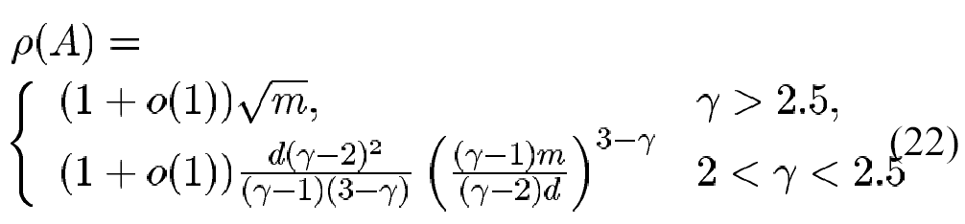
Power-law random graph (2)
Spectral radius of PLRG’s [Chung et al.,03]:
Denote by m max. expected degree w₁, and d average of expected degrees.
Then:

Slide 45
Power-law random graph (3)
Outcome of epidemics on PLRG:
Determined by epidemics on core of graph;
γ>2.5: core = star (top node + neighbours)
2<γ<2.5: core = E-R graph connecting top nodes.

Slide 46
Talk outline (1): Single message dissemination
Unstructured case:
Fraction of receivers reached
giant components in random graphs;
ODE models: impact of “rumour mongering”;
Probability of successful broadcast
Erdos-Renyi phase transition for graph connectivity
Time to successful broadcast
Infect and die model: Diameter of random graphs
Infect forever model: Pittel’s identity
Topologically structured case:
Time to broadcast and graph diameter
Time to specific target in interest-based topologies
Information persistence:
Fast extinction and spectral radius of graph
Long survival and isoperimetric constant of graph
Graph adaptation
Metropolis algorithm and failure resilience
Notes:
A (biased) survey of mathematical models, results and open problems in the area

Slide 47
Designing suitable topologies
Goal: Adapt overlay graph structure, to:
Improve resilience to failures,
Reduce network load,
Achieve fast propagation.
Notes:
The application one should have in mind here is a low level one, namely fast message dissemination. For the last two items we thus want the overlay structure to reflect the underlying network’s structure.

Slide 48
Network Awareness
Cost of overlay connection (i,j):
Communication cost = number of network hops n(i,j);
Application cost = propagation delay from i to j
(both measured by ping).
→ Assumption: some function c(i,j) captures network cost, to be minimised; easily measured.
Notes:
More precisely, we want to have some network awareness in order to reduce the two types of costs described here.. The number of per-link message transmissions for one message dissemination along an edge is the number of links (network hops) between the two peers.

Slide 49
Failure Resilience
i.e., preservation of connectivity in the presence of link / node failures.
Benchmark: connectivity of random graphs
⇒ Random graph on N nodes, with mean degree of c.log(N) supports node or link failure rates up to 1-1/c.
degree distribution
disconnections: due to isolated nodes
Notes:
The other objective we try to achieve is failure resilience. … Here we shall be concerned mostly with random, uniform (uncorrelated) failures. A useful result in order to understand what is needed in that context is provided by an old result on connectivity of random graphs, established in the sixties by Erdos and Renyi.

Slide 50
Formal problem statement
Adapt graph in a distributed way, keeping number of edges fixed, so as to reduce
objective function
Parameter w:
controls trade-off between objectives
d_{i}=degree of node i;
Forces degree balancing
c(i,j)=cost of maintaining connection (i,j), to both network and overlay app.

Slide 51
Solution: a Metropolis algorithm
Periodically each node i picks two current neighbours j, k
Candidate rewiring:
Local evaluation of impact on energy:
Rewiring accepted with probability:
j
k
j
k
i
i

Slide 52
Metropolis algorithm (2)
Defines Markov chain on set of connected graphs with initial number of edges E, and stationary distribution
hence concentrates on low energy configurations.

Slide 53
Failure resilience properties
Key result:
For an average degree of c.log(N), c>0,
resulting graph remains connected for link failure rates up to exp(-1/c).
Improves upon failure resilience of uniform random graphs (cf. Erdös-Renyi law);
Essentially optimal failure resilience for uniform random link failures.
Notes:
We have the following result for graphs drawn according to this distribution, if we ignore the “network cost” part in the energy function.

Slide 54
Open problems:
Design decentralised schemes that optimise topology w.r.t more realistic network /delay costs
Candidate option:
overlay optimised aggressively towards locality;
Augmented with random shortcuts.
→ reduced diameter (small world phenomenon).
Optimise for other notions of locality (interest-based,…)

Slide 55
Multi-message dissemination
File dissemination and time to broadcast:
K+log(N) lower bound
Random network coding:
Optimality of “algebraic gossip”
Badness of random pull
Optimality without network coding:
Priority push+source coding
Interleaved push and pull
Live streaming and broadcast rate:
The min(min-cut) upper bound
Optimality of random linear coding
Optimality of “Random-Useful-Push”

Slide 56
Problem description
Users aim to obtain a file, sliced into K “chunks”
Server may provide users with initial chunks
Users then exchange chunks among themselves, to complete their collection.
Candidate exchange strategies:
Who to exchange with (here, random target)
What to exchange:
Rarest chunks first (implemented in BitTorrent)
Random (among useful chunks)
“Random Linear Combination” of available chunks

Slide 57
Basic Models
Fixed population of N users.
Each user contacts random target at each time slot;
Pulls (pushes) one chunk from (to) target according to some policy.
Performance of interest:
completion time for all users

Slide 58
Lower bound on performance:
Assume central controller dictates who downloads what from whom.
Optimal completion time of order:
K (time for arbitrary user to complete)
+
log(N) (time for arbitrary item to disseminate)
[Cockayne-Thomason,80]; [Mundiger-Weber,04]

Slide 59
Multi-message dissemination
File dissemination and time to broadcast:
K+log(N) lower bound
Random network coding:
Optimality of “algebraic gossip”
Badness of random pull
Optimality without network coding:
Priority push+source coding
Interleaved push and pull
Live streaming and broadcast rate:
The min(min-cut) upper bound
Optimality of random linear coding
Optimality of “Random-Useful-Push”

Slide 60
Random Linear coding
[Ho-Medard-Effros-Karger]
Individual messages: vectors v₁,…,v_{K} over finite field, F.
User holding [w₁,…,w_{m}]=[v₁,…,v_{K}] [a₁,…a_{m}]
transmits w=[w₁,…,w_{m}]b for random coefficients b₁,…b_{m},
together with vector of coefficients: a’= [a₁,…a_{m}]b.
Decoding feasible when rank[a₁,…,a_{m}]=K.

Slide 61
“Algebraic gossip” vs blind push/pull: [Deb&Medard, 04]:
For K» α N :
Random Linear Coding has optimal order (K)
Blind random push (push randomly selected packet, irrespective of target’s state):
order Ω(K log(N) )
Same lower bound for blind random pull.

Slide 62
Multi-message dissemination
File dissemination and time to broadcast:
K+log(N) lower bound
Random network coding:
Optimality of “algebraic gossip”
Badness of random pull
Optimality without network coding:
Priority push+source coding
Interleaved push and pull
Live streaming and broadcast rate:
The min(min-cut) upper bound
Optimality of random linear coding
Optimality of “Random-Useful-Push”

Slide 63
Priority push: [Sanghavi,Hajek,M. 06]
Chunks are labelled 1…K;
Source pushes chunk j in slot j;
Other nodes: always push highest label chunk they have.
With high probability, item j present at (1-e⁻¹-δ)N nodes by time j+(1+δ)log(N).
Hence: if source sends encoded (eg, with Luby’s LT-codes) chunks, completes in time O(K+log(N)).

Slide 64
Interleave protocol: [Sanghavi,Hajek,M.06]
Source does as in priority push;
In odd-time slots: nodes push highest label chunk they obtained from push;
In even-time slots: nodes pull lowest label chunk they don’t have yet.
→For K ≤ Nª, and some fixed exponent a, with high prob.:
Interleave succeeds in time 10(K+log(N)).
Hence: optimal order, without source or network coding.

Slide 65
Open problems
Performance of systems where users depart when collection complete: absorbing state?
(with random useful pull, RLC, rarest first, encoding only at source, …)
→ Results in [M.-Vojnovic,05] suggest random pull efficient
Performance impact of restrictions on who users can exchange with (topological constraints)?
→ [Mosk-Ayoma & Shah 06] address another version of the problem: 1 item per user (N=K, multi-source)

Slide 66
Outline
File dissemination and time to broadcast:
K+log(N) lower bound
Random network coding:
Optimality of “algebraic gossip”
Badness of random pull
Optimality without coding:
Priority push+source coding
Interleaved push and pull
Live streaming and broadcast rate:
The min(min-cut) upper bound
Optimality of random linear coding
Optimality of “Random-Useful-Push”

Slide 67

Live streaming problem
Transmit live data stream from a source to all nodes
Over unstructured (overlay) network
Where nodes have no global knowledge
Goal: Efficient decentralized broadcast schemes
Metrics: minimum rate, playback delay
Constraints:
Limited edge capacities

Slide 68
Theoretical limit on performance:
broadcast rate, λ* = min [ mincut(s,i): i2V ]
[Edmonds, 1969]
λ* = min number of edges to disconnect some node from s
Can be achieved by packing edge-disjoint spanning trees [Edmonds,Lovasz, Gabow,…] centralized algorithms
s
s
s
1
1
+
1
a
b
a
b
a
b
1
1
1
c
c
c

Slide 69
Challenges:
Aim for decentralised schemes;
Don’t want explicit tree construction:
simplifies management when nodes arrive and leave;
Manage tension between timeliness and diversity:
in-order delivery from s to a & b reduces potential rate from 2 to 1.
2
s
1
1
1
a
1
b
1
1

Slide 70
Optimality of Random Linear Coding
RLC with sufficiently large finite field size achieves optimal broadcast rate
[Ho et al.03];
seminal works: [Ahlswede et al.00], [Li,Yeung,Cai03]
In fact, applies more generally:
Multicast (nodes not all receivers; some are relays)
Multi-source

Slide 71
Random Useful packet forwarding
Let P(u) = packets received by u
for each edge (u,v)
send a random packet from P(u) \ P(v)
λ
New packets injected at rate λ
s
a
b
c

Slide 72
Random Useful packet forwarding
[M.,Twigg,Gkantsidis,Rodriguez 06]
Theorem
For every edge-capacitated graph G and λ < λ*(G), Random Useful packet forwarding achieves λ
Where: λ = injection rate
λ* = optimal broadcast rate
= min(mincut(s))
More precisely:
number of packets present at source and not yet broadcast fluctuates around finite equilibrium value.
Notes:
Result to be qualified on next slide.

Slide 73
Open problems:
Live streaming: understand playback delay performance;
Video-on-Demand: users don’t necessarily play back in synchrony;
Interplay between local dissemination strategy (eg, Random Useful) and topology adaptation.

